Slide 1
WordNet Similarity
http://ws4jdemo.appspot.com/

Slide 2
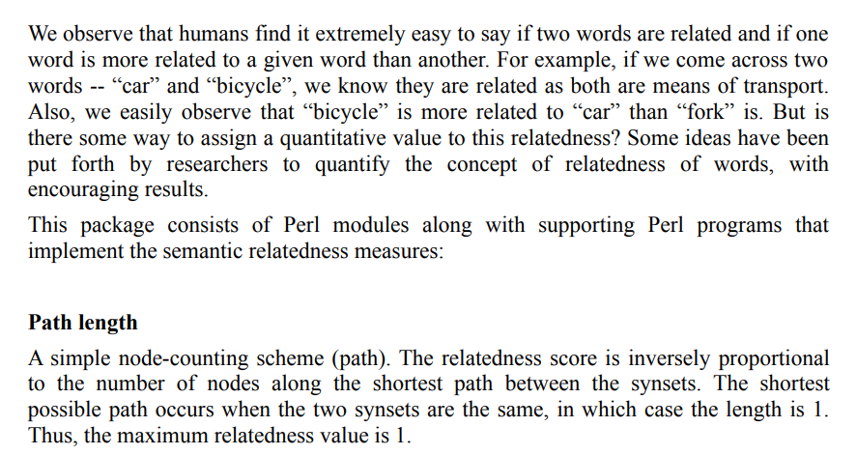

Slide 3
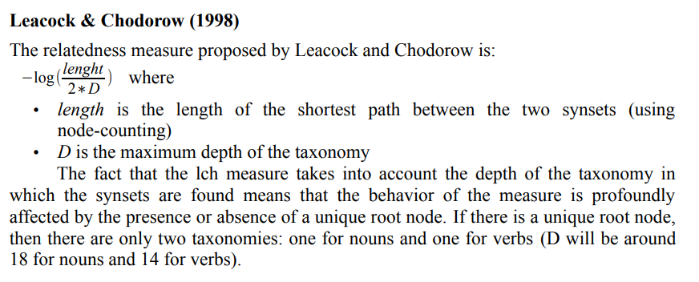

Slide 4



Slide 5
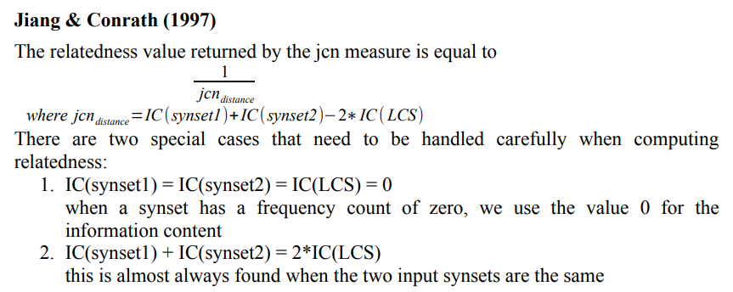


Slide 6

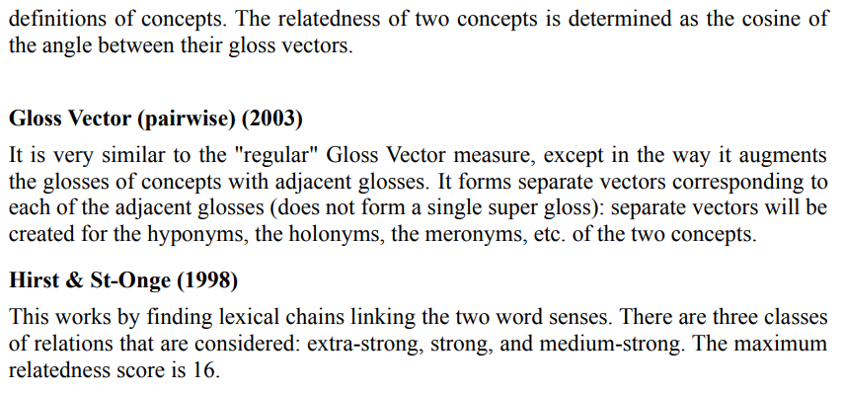

Slide 7


